Slide 1
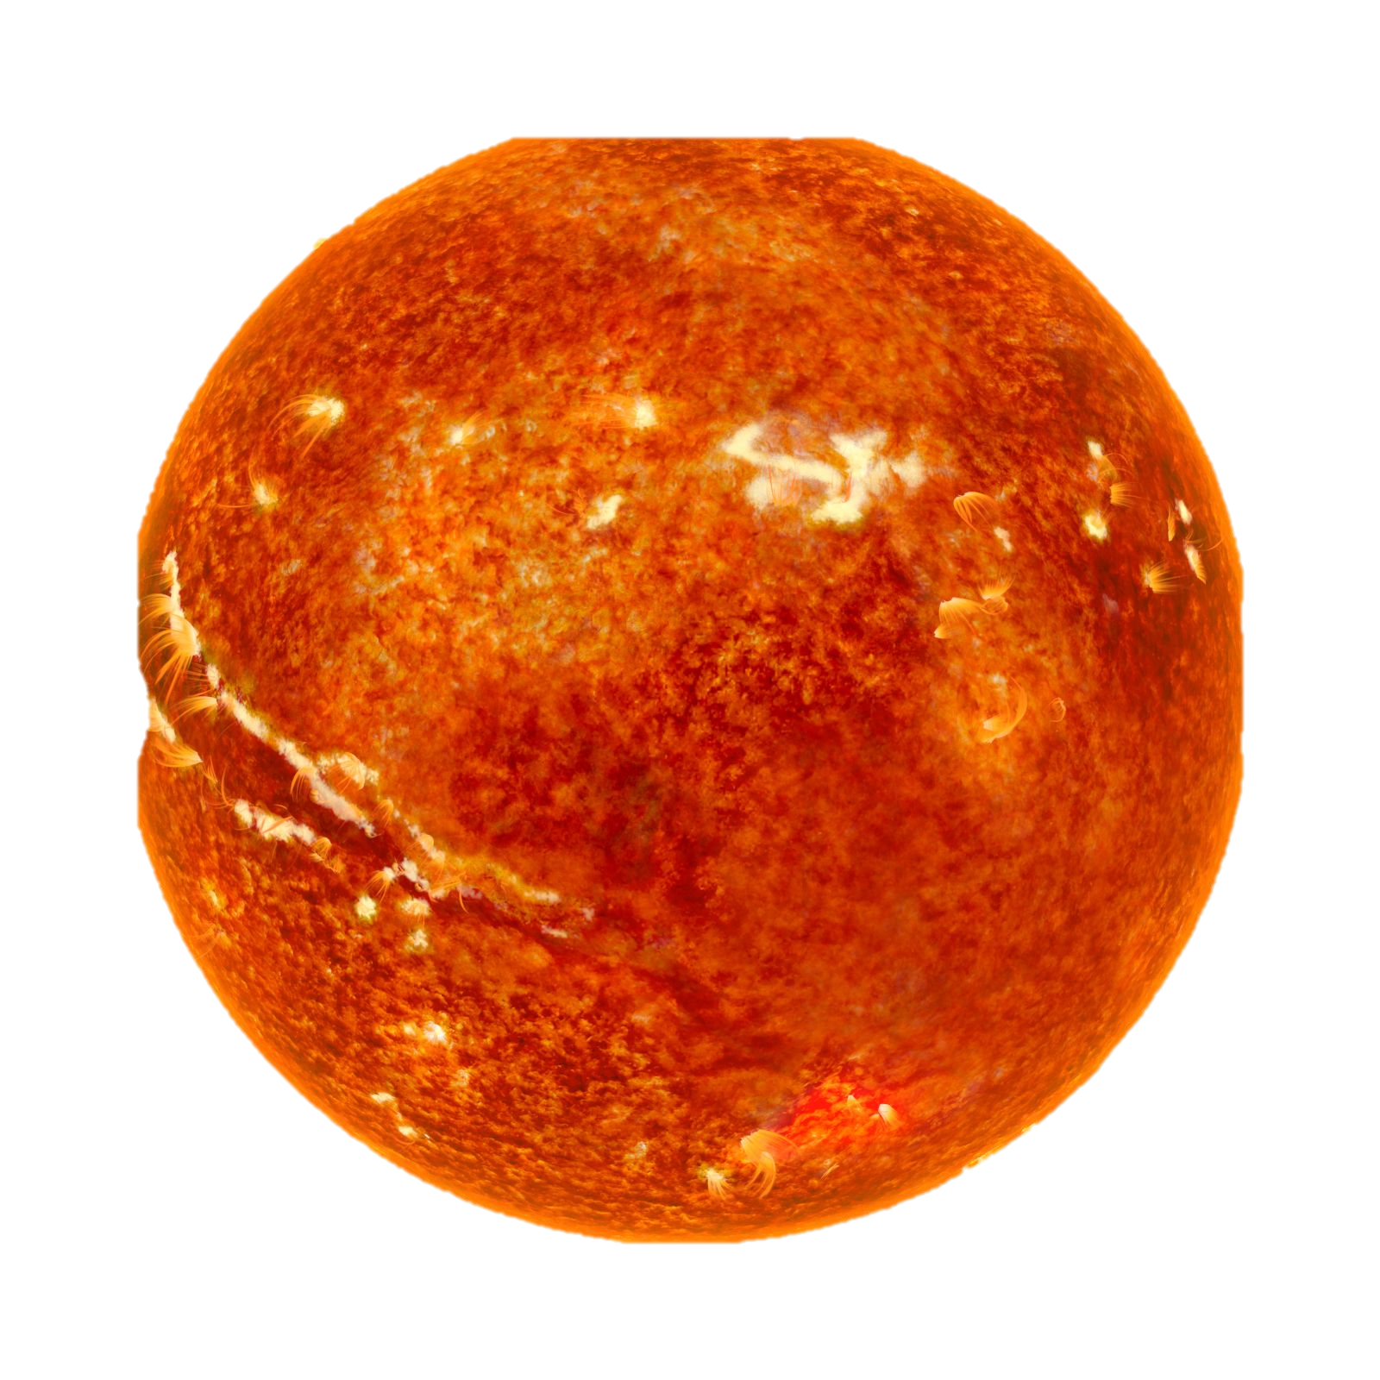
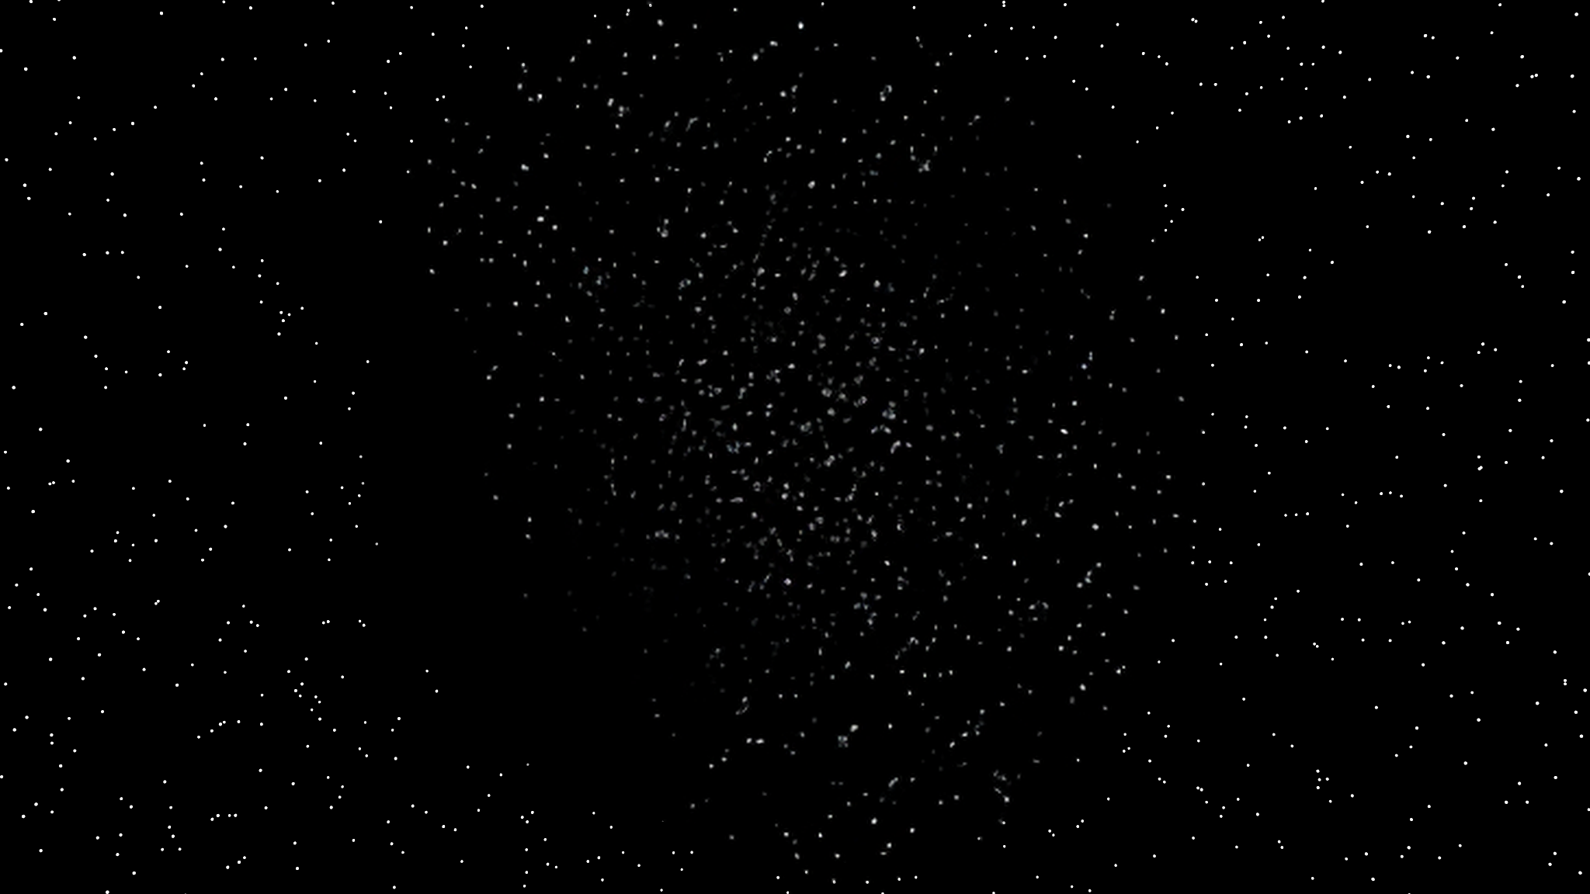
LIFE OF A STAR
Alfonso Cavallo

Slide 2
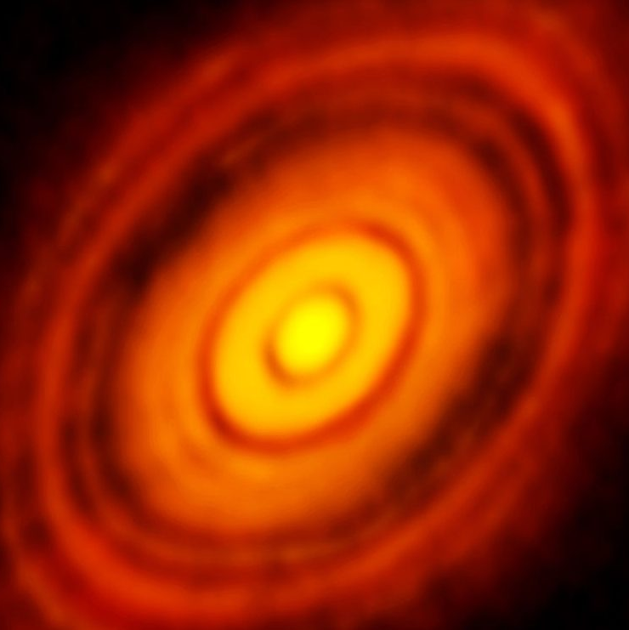
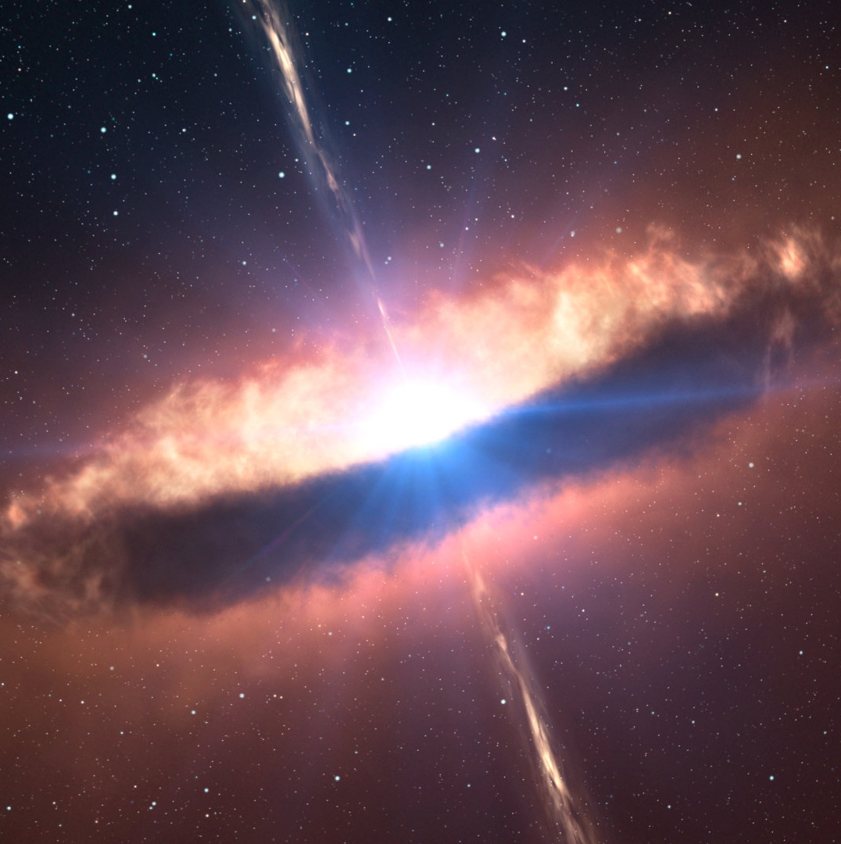
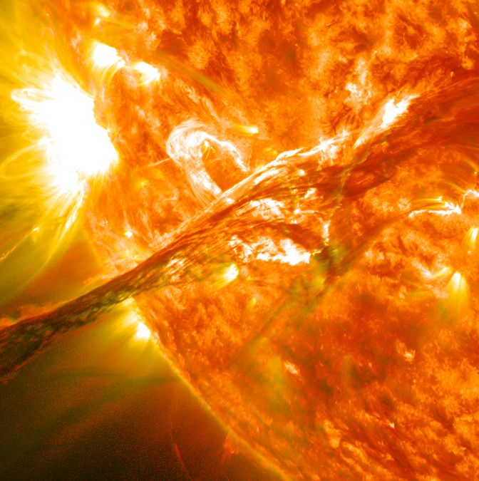


LIFE OF A STAR
Birth of a Star
Main Sequence
A star starts forming from gas when matter collapses into a sphere due to gravity
The star burns hydrogen in the core, producing energy until the fuel is consumed
$${10}^{4}−{10}^{7} years$$
Pre-Main-Sequence
In this phase the star accretes material and starts forming. The lower the mass, the longer the process
$${10}^{7}−{10}^{10} years$$

Slide 3
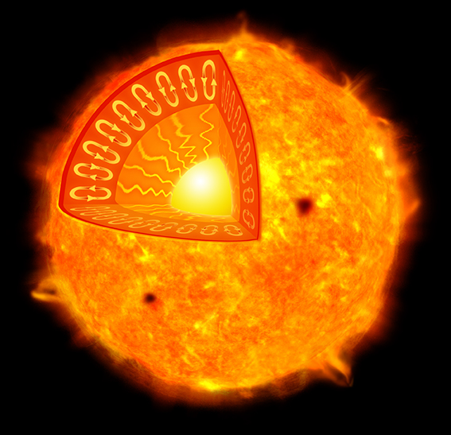
WHAT IS A STAR
Envelope
Transports energy to the surface.
Photosphere
Emits most of the light irradiated by the star.
Core
Burns Hydrogen and produces energy which is irradiated outward, balancing the gravity
Chromosphere
It is typically red and lies right above the photosphere.
Corona
The outer material in a star

Slide 4
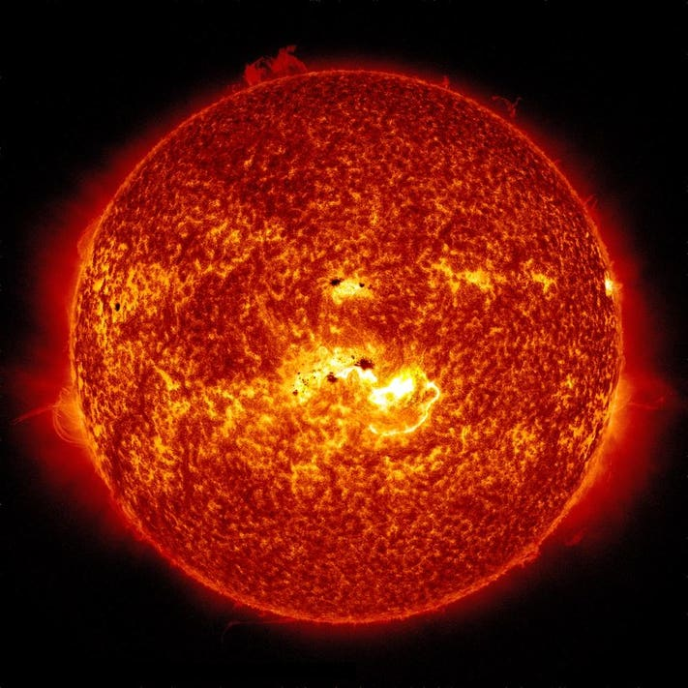
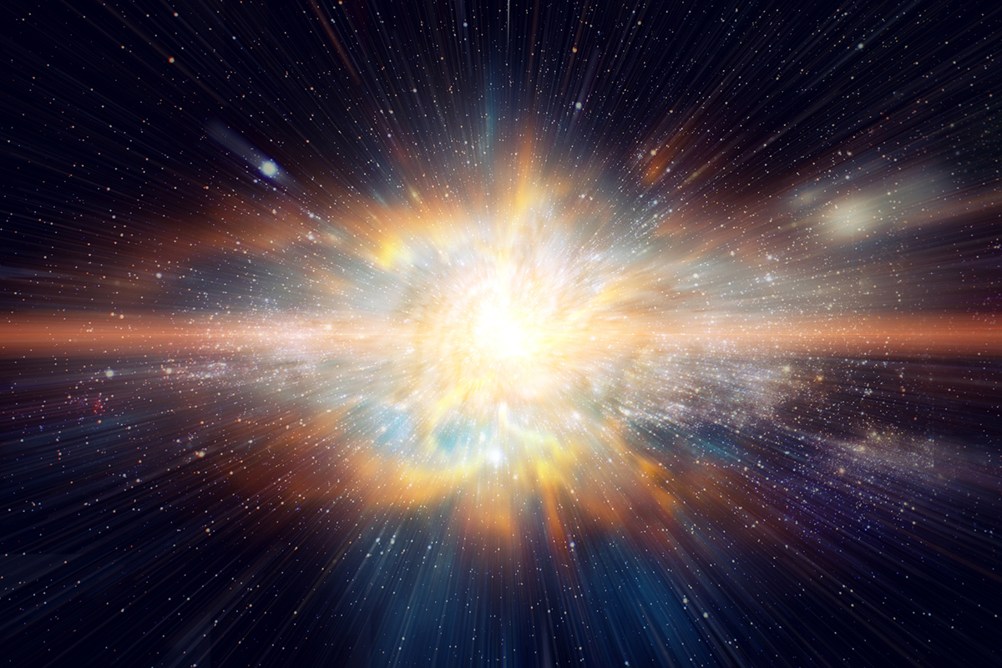
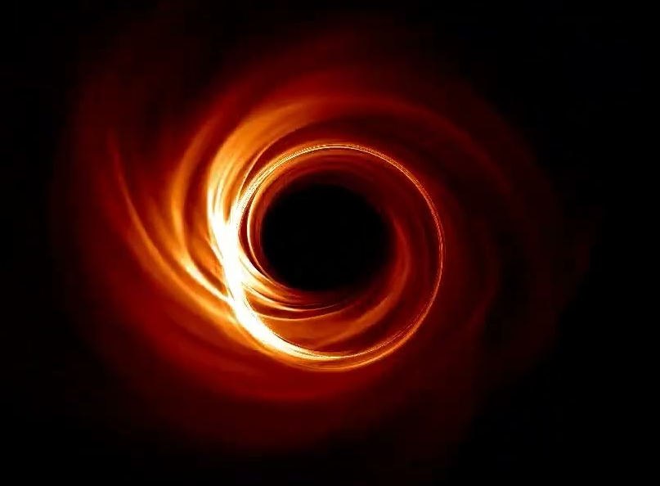
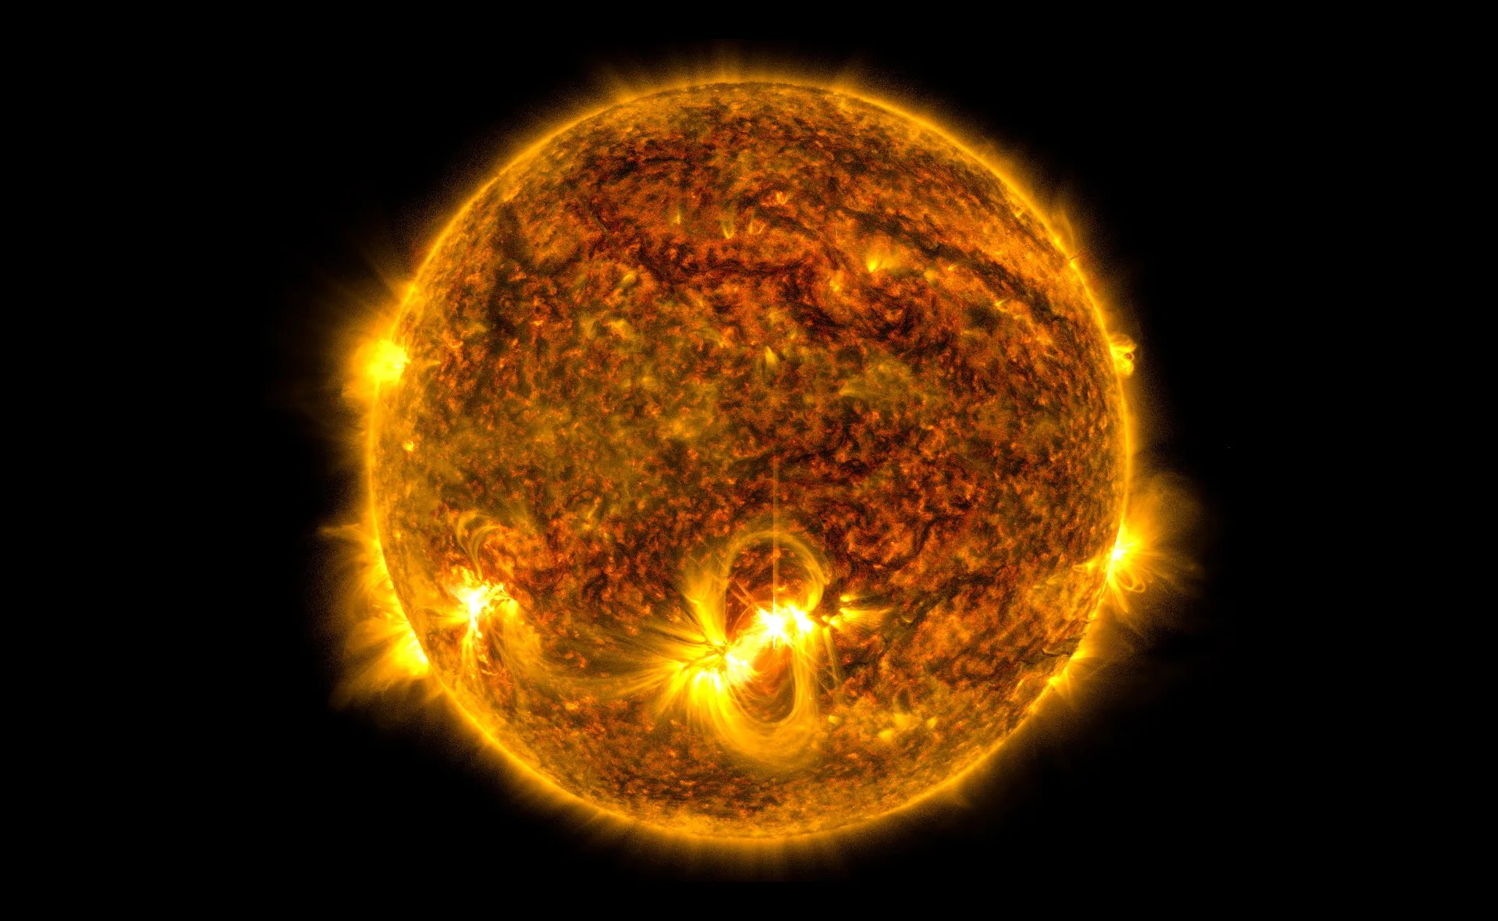
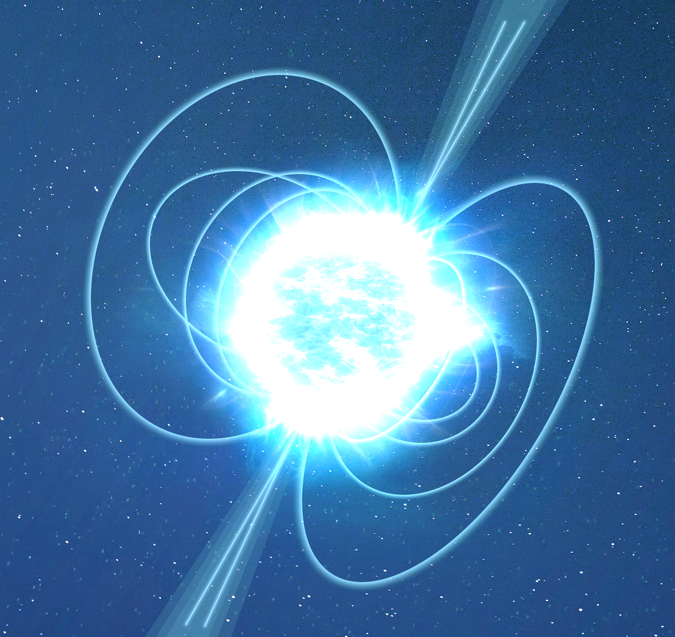
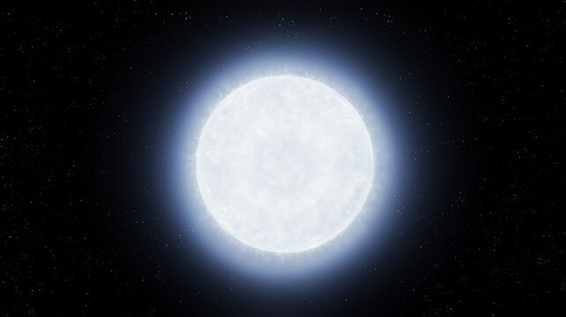
HOW DOES A STAR DIE?
Release energy into a high-energy explosion
All the mass collapses into one single infinitely dense point
Massive Star
Supernova
Black Hole
Runs out of Hydrogen
Red Super-Giant
Neutrons contract until their pressure stabilizes
Electrons contracts until their pressure stabilzes
Neutron Star
Light Star
The life of a star is proportional to its mass. The more massive, the more luminous, the sooner it runs out of fuel
Red Giant
White Dwarf

Slide 5

01
EQUATIONS

Slide 6









HYDROSTATIC EQUILIBRIUM
$$Outward$$
$$Pressure$$
$$P\left(r\right)ds$$
$$δs$$
$$δr$$
$$P\left(r+dr\right)ds+\frac{GM\left(r\right)}{r^{2}}dm$$
$$Inward \\ Gravity$$
$$r$$
$$dm=ρ\left(r\right)dsdr$$
$$P\left(r+dr\right)ds+\frac{GM\left(r\right)}{r^{2}}ρ\left(r\right)dsdr$$

Slide 7




HYDROSTATIC EQUILIBRIUM
The two forces must be in equilibrium to keep the star stable
$$P\left(r\right)ds=P\left(r+dr\right)ds+\frac{GM\left(r\right)}{r^{2}}dm$$
$$P\left(r+dr\right)−P\left(r\right)=−\frac{GM\left(r\right)}{r^{2}}ρ\left(r\right)drds$$
Move the pressure terms on the left side of the equation.
$$\frac{dP\left(r\right)}{dr}=−\frac{GM\left(r\right)}{r^{2}}ρ\left(r\right)$$
Dividing both members by $dr$ with $dr→0$ is the same as computing the derivate of the pressure with respect to the radius.

Slide 8







MASS CONSERVATION
$$dM=dVρ(r)$$
The variation of mass in between an infinitely thin envelope must equal the product between such volume and the density at that radius
$$dV=4πr^{2}dr$$
$$r$$
$$dM=4πr^{2}ρ\left(r\right)dr$$
$$r+δr$$
Dividing both members by $dr$ with $dr→0$ is the same as computing the derivate of the mass with respect to the radius.
$$\frac{dM\left(r\right)}{dr}=4πr^{2}ρ\left(r\right)$$

Slide 9





ENERGY PRODUCTION
$$Rate of energy across \\ the sphere of radius r$$
$$L\left(r\right)$$
$$r$$
$$r+δr$$
$$Rate of energy one \\ infinitesimal distance$$
$$over the sphere$$
$$L_{r}$$
$$L\left(r+dr\right)$$
$$L_{r+δr}$$

Slide 10



ENERGY PRODUCTION
The energy produced in between this infinitely thin envelope cannot exceed the mass contained inside it. $→ ε<1$
$$L\left(r+dr\right)=L\left(r\right)+dMε$$
$$dM=4πr^{2}ρdr$$
$$r$$
$$r+δr$$
$$L_{r}$$
$$L\left(r+dr\right)=L\left(r\right)+4πr^{2}ρdrε$$
$$L_{r+δr}$$
$$\frac{dL\left(r\right)}{dr}=4πr^{2}ρε$$

Slide 11

ENERGY TRANSPORTATION
$$\frac{dI_{v}}{dr}cosθ=−k_{v}ρI_{v}+j_{v}$$
Radiative transfer equation

Slide 12










ENERGY TRANSPORTATION
$$\frac{dI_{v}}{dr}cosθ$$
$$\frac{d}{dr}∫∫I_{v}\cos^{2}{θ}dΩdv=$$
Multiply by $cosθ$ and integrate over $Ω$ and $v$
$$\frac{d}{dr}∫\cos^{2}{θ}dΩ∫I_{v}dv=$$
$$\frac{d}{dr}\frac{4}{3}π∫I_{v}dv=$$
$$F_{v}=πI_{v}$$
Flux of an isotropic source
$$\frac{d}{dr}\frac{4}{3}∫F_{v}dv=$$
$$\frac{d}{dr}\frac{4}{3}F=$$
$$F=σT^{4}$$
Stephan-Bolzmann law
$$\frac{d}{dr}\frac{4}{3}σT^{4}=$$

Slide 13





ENERGY TRANSPORTATION
$$−{I_{v}k}_{v}ρ$$
$$−∫∫I_{v}k_{v}ρcosθdΩdv=$$
Multiply by $cosθ$ and integrate over $Ω$ and $v$
$$−ρ∫cosθdΩ∫I_{v}k_{v}dv=$$
$−ρπIk=$
$−ρFk$
$$j_{v}$$
$$−∫∫j_{v}cosθdΩdv=$$
Multiply by $cosθ$ and integrate over $Ω$ and $v$
$$∫cosθdΩ∫j_{v}dv=0$$

Slide 14


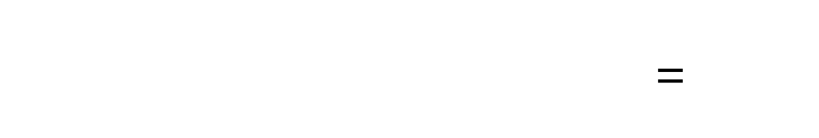
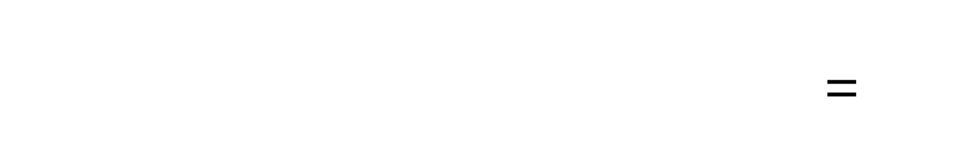

ENERGY TRANSPORTATION
$\frac{d}{dr}\left(\frac{4}{3}σT^{4}\right)=−kρF$=
$\frac{d}{dr}\left(\frac{4}{3}ρT^{4}\right)=−\frac{kρL}{4πr^{2}}$=
$\frac{d}{dT}\left(\frac{4}{3}ρT^{4}\right)\frac{dT}{dr}=−\frac{kρL}{4πr^{2}}$=
$\left(\frac{16}{3}ρT^{3}\right)\frac{dT}{dr}=−\frac{kρL}{4πr^{2}}$=
$\frac{dT}{dr}=−\frac{3kρL}{16{σT}^{3}4πr^{2}}$=

Slide 15










FINAL SYSTEM
$$\frac{dP\left(r\right)}{dr}=\frac{GM\left(r\right)}{r^{2}}ρ(r)$$
$$Hydrostatic \\ Equilibrium$$
$$Boundary Conditions$$
$$At the centre M=0, L=0, r=0 \\ At the surface M=M_{∗},L=L_{∗},r=r_{∗}$$
$\frac{dM\left(r\right)}{dr}=4πr^{2}ρ(r)$=
$$Conservation \\ of mass$$
$$+$$
$$Additional equations:$$
$$\frac{dL\left(r\right)}{dr}=4πr^{2}ρ\left(r\right)ε$$
$$Conservation \\ of energy$$
$$P=P(ρ,T, chemical composition)$$
$$k=k(ρ,T, chemical composition)$$
$$Radiative \\ Transport$$
$$ε=ε(ρ,T, chemical composition)$$
$\frac{dT}{dr}=−\frac{3kρL}{16ρT^{3}4πr^{2}}$=

Slide 16









TIME SCALES
$$r=\frac{1}{2}at_{d}^{2}=\frac{GM}{2r^{2}}t_{d}^{2} → t_{d}=\sqrt{\frac{2r^{3}}{GM}}≈30 minutes$$
$$Dynamical Timescale$$
$$t_{th}=\frac{T}{L}$$
$$t_{th}=\frac{GM^{2}}{2rL}≈30Myrs$$
$$Thermal Timescale$$
For the Virial Theorem $T=−\frac{U}{2}$
$$U=−\frac{GM^{2}}{r}$$
$$t_{nuc}=\frac{εMc^{2}}{L}$$
$$t_{nuc}≈10Gyrs$$
$$Nuclear Timescale$$

Slide 17
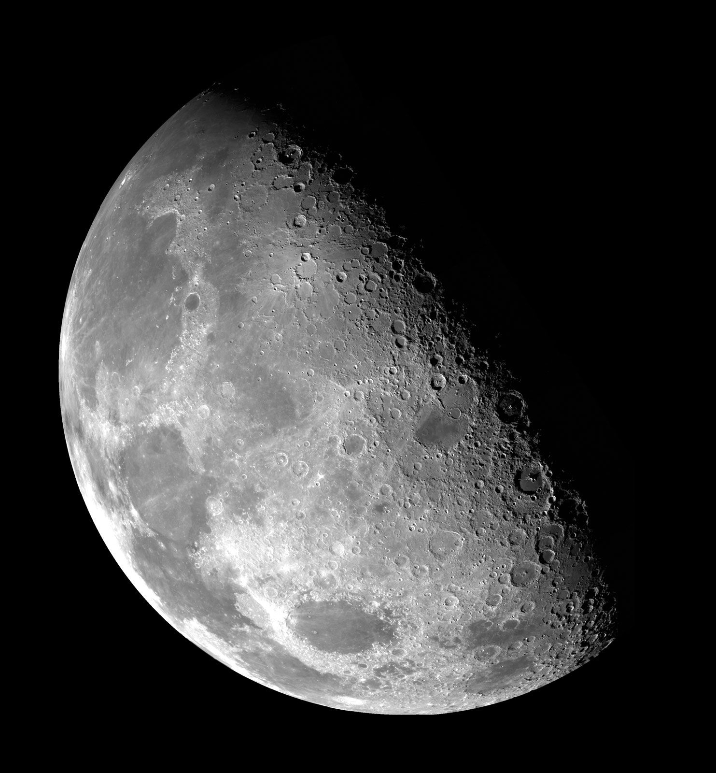
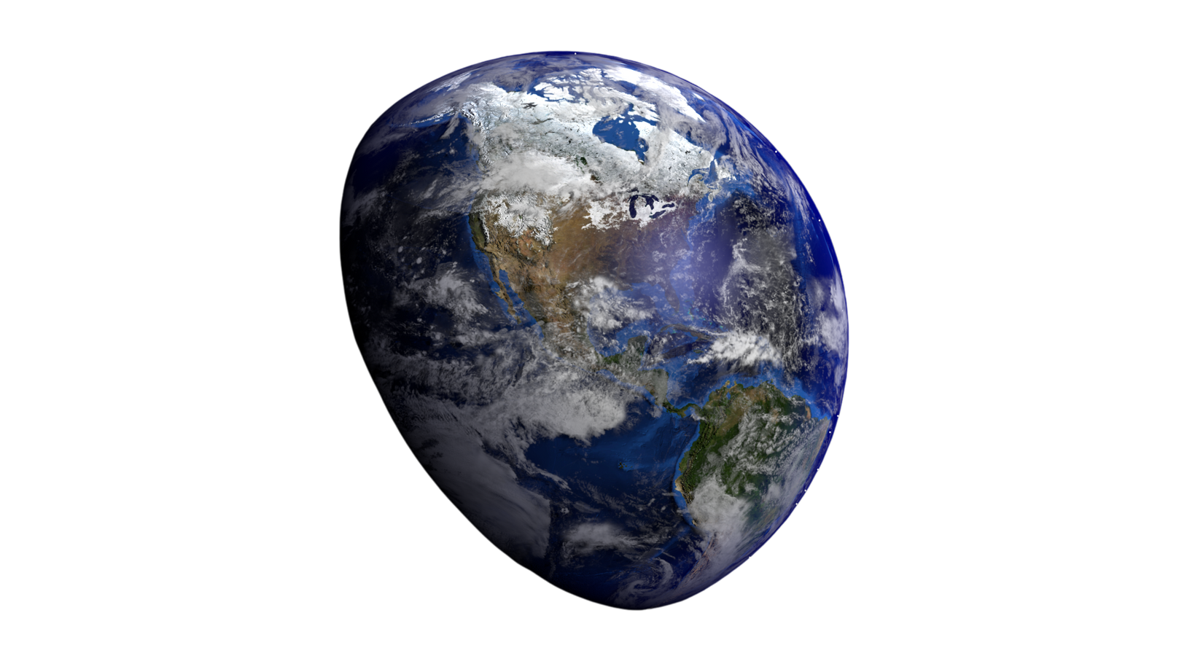
THANK YOU
fOR THE
ATTENTION

